Slide 1
Chapter 10 – Microfabrication Technology in Tissue Engineering

Slide 2
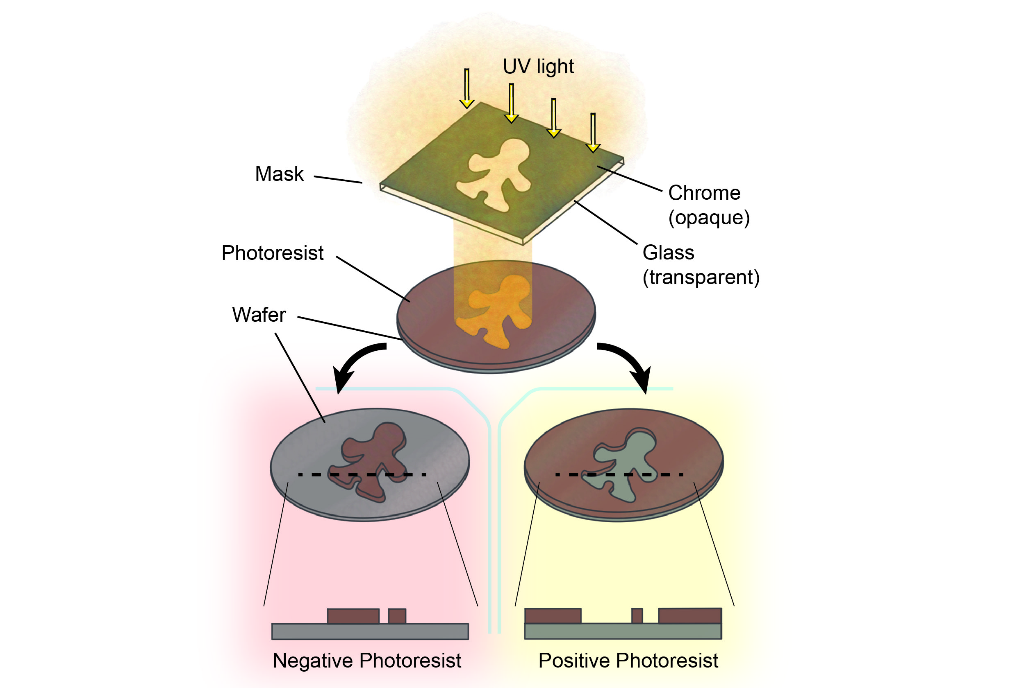
Notes:
Figure 10.1: The typical workflow of photolithography to achieve the fabrication of microscale structures.

Slide 3
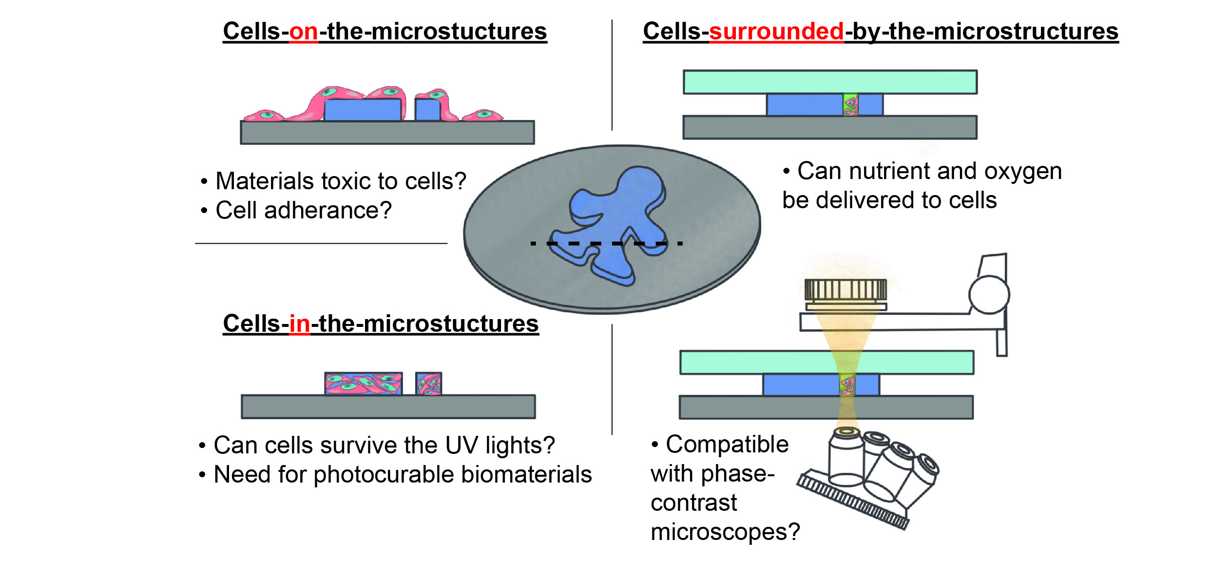
Notes:
Figure 10.2: Various scenarios for the application of photolithography to TE. First, cells can be directly inoculated on top of the microstructures. Second, cells can become part of the microstructures. Third, cells can be confined in the microscale chambers/reservoirs or channels.

Slide 4
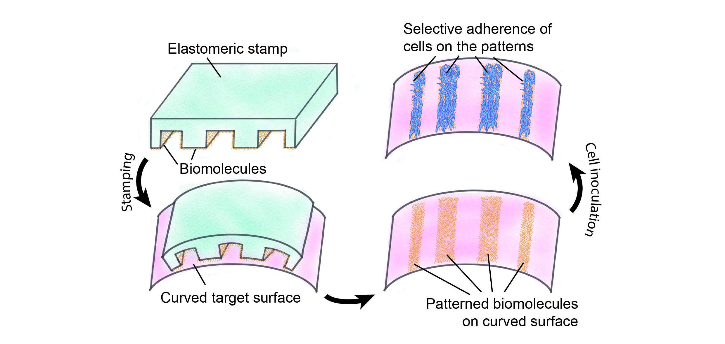
Notes:
Figure 10.3: Schematic illustration of microcontact printing (µCP) by the example of patterning cells on a curved surface.

Slide 5
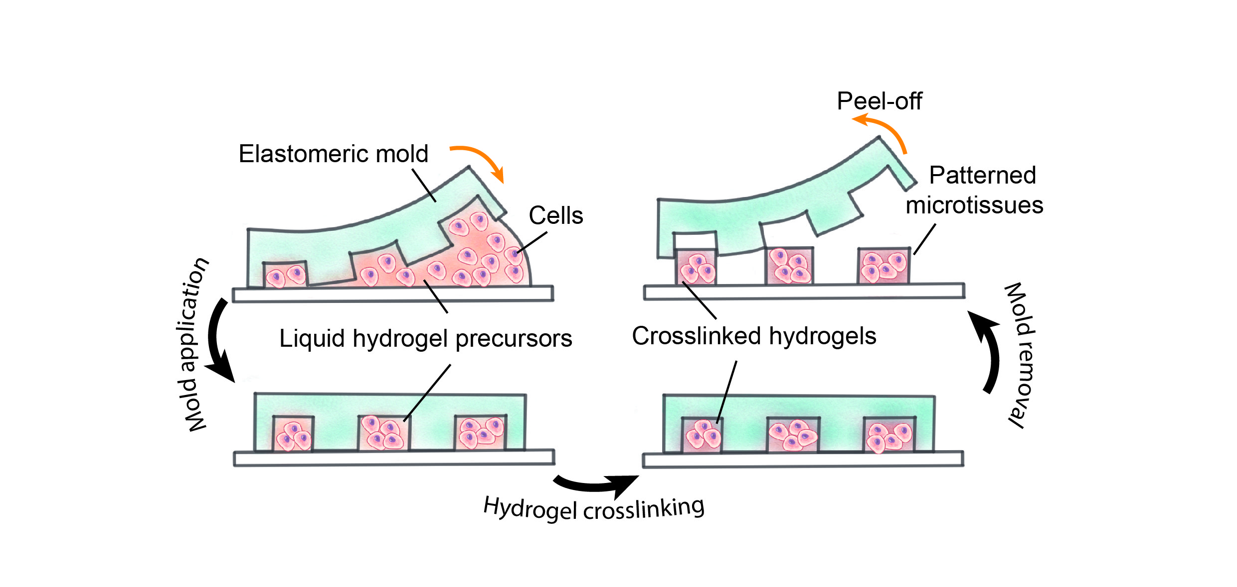
Notes:
Figure 10.4: Schematic illustration of a tissue micromolding technology to fabricate patterned microtissues.

Slide 6
Notes:
Figure 10.5: Two typical designs for the formation of microemulsions: the T-junction channels and flow-focusing channels.
From Point-, line-, and plane-shaped cellular constructs for 3D tissue assembly, Morimoto et al., 2015 Advanced drug delivery reviews, 95, pp. 29–39.

Slide 7
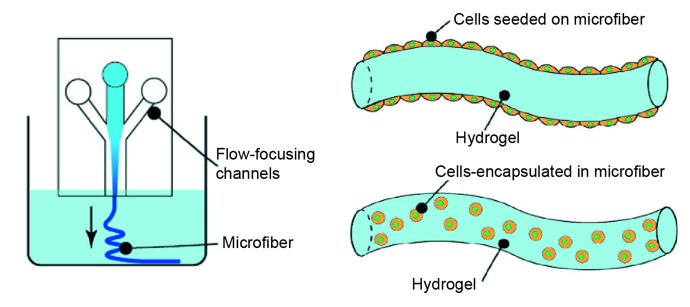
Notes:
Figure 10.6: The use of flow-focusing channels to produce line-shaped microtissues by using aqueous fluids as the focusing fluid.
From Cell-laden microfibers for bottom-up tissue engineering, Onoe and Takeuchi, 2015 Drug discovery today, 20(2), pp. 236–246.

Slide 8
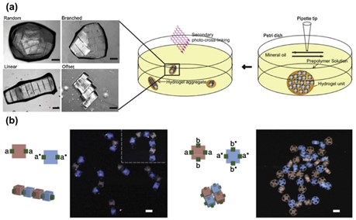
Notes:
Figure 10.7: Self-assembly of tissue microstructures to form larger tissue constructs. Scale bar: 200 µm.
From DNA-directed self-assembly of shape-controlled hydrogels , Qi, H. et al., 2013, Nature communications, 4, p. 2275.

Slide 9
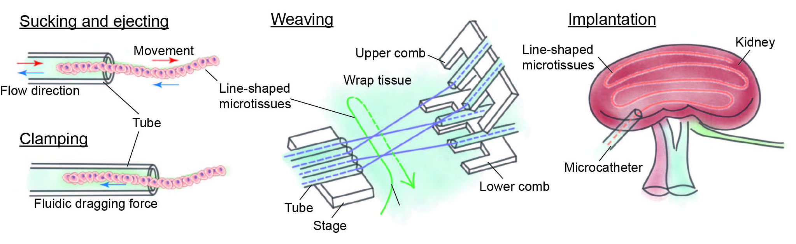
Notes:
Figure 10.8: Textile technology in combination with the microfluidic manipulation of line-shaped microtissues (a.k.a. ‘cell-laden (micro)fibers’).

Slide 10
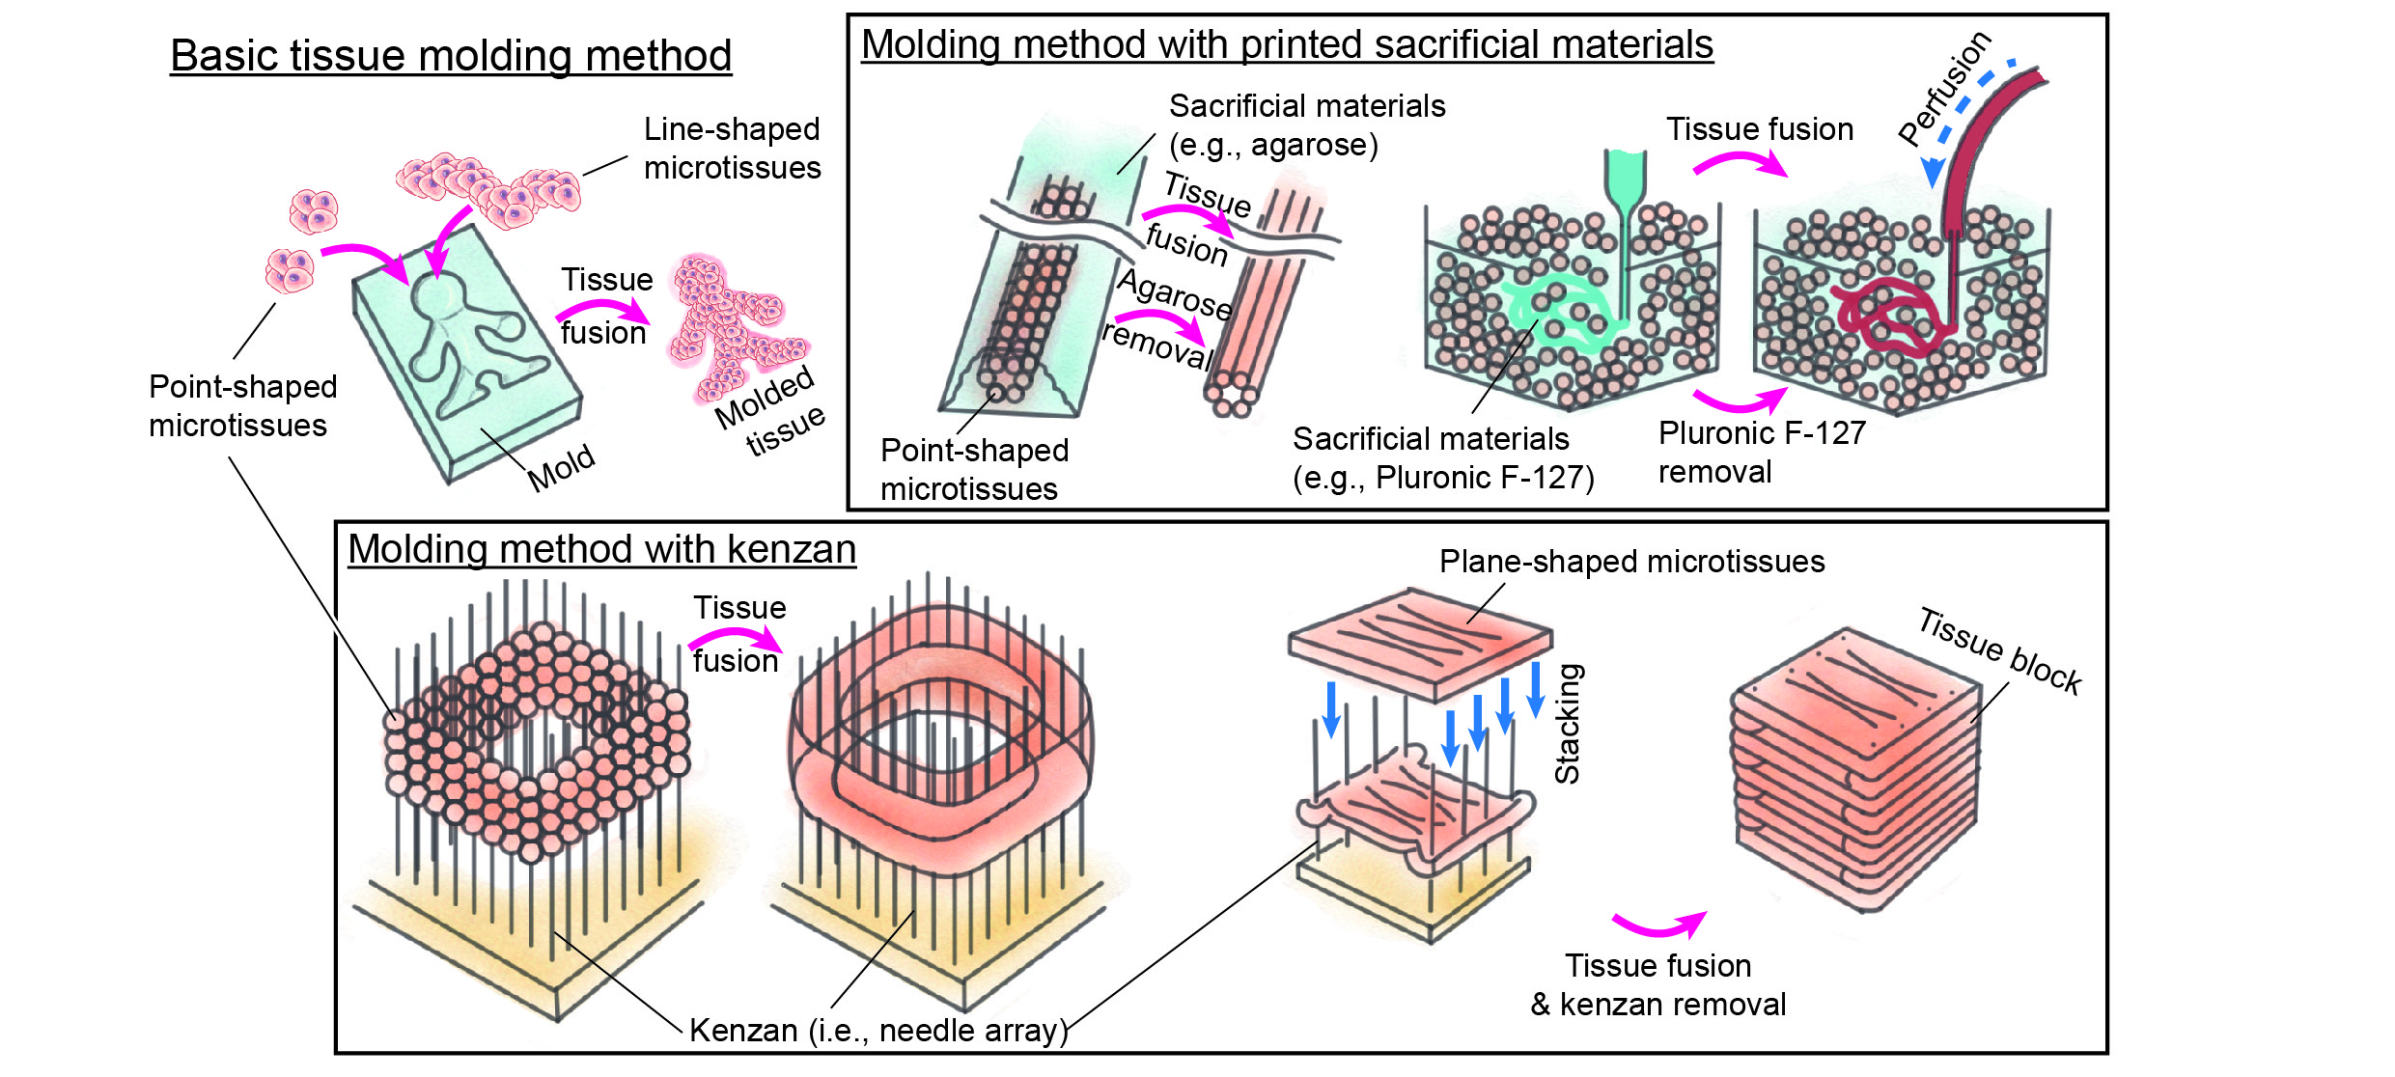
Notes:
Figure 10.9: Templated molding of microtissues using tissue fusion and line-shaped microtissues.

Slide 11
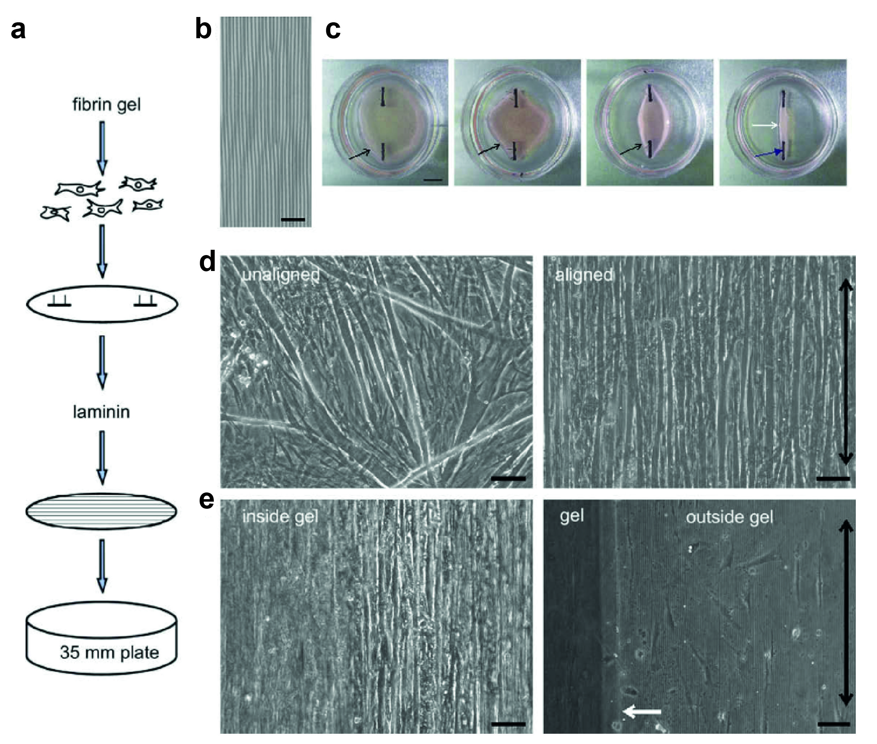
Notes:
Figure 10.10: Formation of 3D tissue with highly aligned myotubes using microfabricated wavy surface patterns: a) Diagram of tissue formation method. b) Microscopic images of the wavy surface pattern on the PDMS slab. c) Rollup process of the 3D tissue. d) Images of cells cultured on flat vs. wavy PDMS. e) Images of cells on the wavy features inside and outside the gel. Scale bars: b) 50 μm; c) 6 mm; d, e) 100 μm.
From Microfeature Guided Skeletal Muscle Tissue Engineering for Highly Organized 3-Dimensional Free-Standing Constructs, Lam, M. et al. Biomaterials 30 (6): 1150–55 (2009).

Slide 12
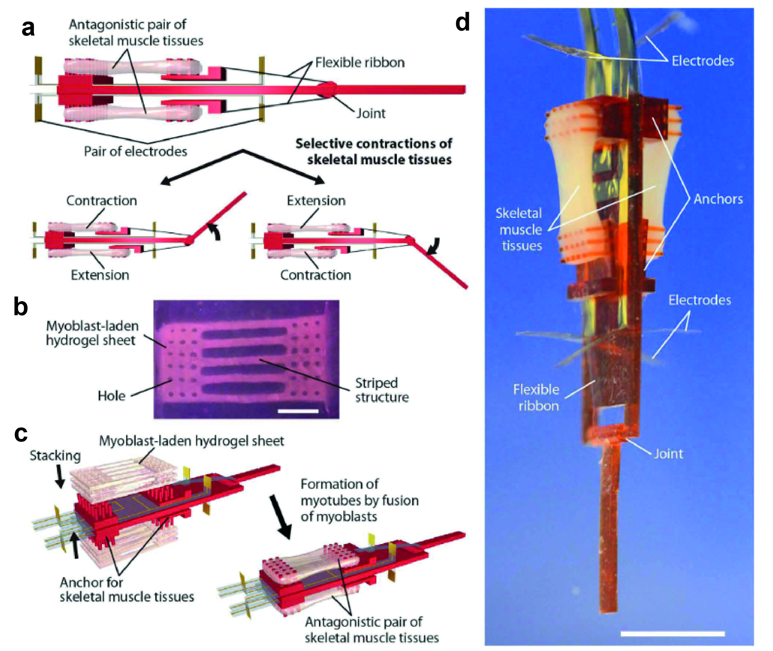
Notes:
Figure 10.11: Biohybrid robot powered by skeletal muscle tissues: a) Scheme of the robot. b) The myoblast-laden hydrogel sheet fabricated using tissue micromolding. c) Formation of the muscle tissues on the skeleton of the robot. d) Photo image of the robot. Scale bars: b) 2 mm; d) 5 mm.
From Biohybrid Robot Powered by an Antagonistic Pair of Skeletal Muscle Tissues, Morimoto et al., 2018, Science Robotics 3 (18): eaat4440.

